Slide 1

Hyper Text Markup Language: HTML5

Slide 2
General Guideline
© (2024) ABES Engineering College.
This document contains valuable confidential and proprietary information of ABESEC. Such confidential and proprietary information includes, amongst others, proprietary intellectual property which can be legally protected and commercialized. Such information is furnished herein for training purposes only. Except with the express prior written permission of ABESEC, this document and the information contained herein may not be published, disclosed, or used for any other purpose.

Slide 3
HTML Topics- Semantic/Non-Semantic elements, Tags(div, span), anchor, iframe, Video, Map, Audio ,img, table, form , list and entities.
Content
Day 1

Slide 4
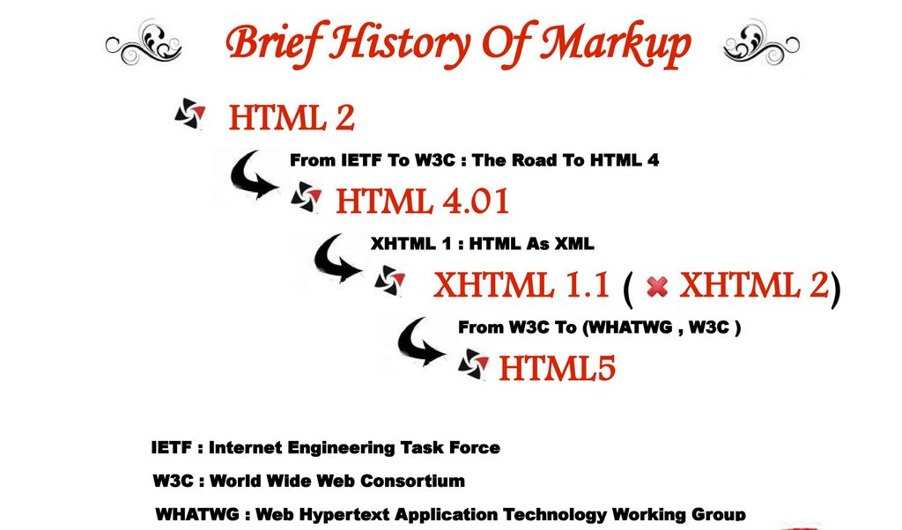

Slide 5
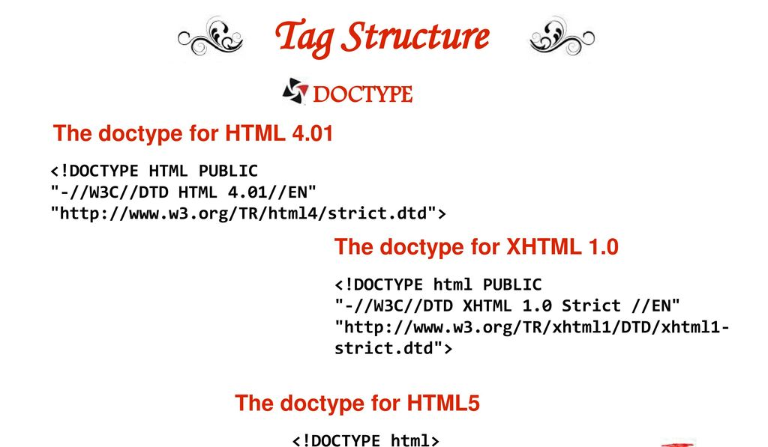

Slide 6
Grouping of Elements.
Grouping in HTML used to be to done using the no-semantic elements(Div and span ) until introduction of semantic elements in HTML5 .
Semantic HTML elements
Non-semantic HTML elements
Semantic elements describes what the content contains as opposed to what it looks like! Semantic markup describes what the content contains as opposed to what it looks like!
Non-semantic element are the element which Tells nothing about its content. In other terms element whose name doesn’t suggest you what they do. e.g. <div> and <span>.

Slide 7
Grouping of Elements.
Grouping in HTML used to be to done using the no-semantic elements(Div and span ) until introduction of semantic elements in HTML5 .
Semantic HTML elements
Non-semantic HTML elements
Semantic elements describes what the content contains as opposed to what it looks like! Semantic markup describes what the content contains as opposed to what it looks like!
Non-semantic element are the element which Tells nothing about its content. In other terms element whose name doesn’t suggest you what they do. e.g. <div> and <span>.

Slide 8
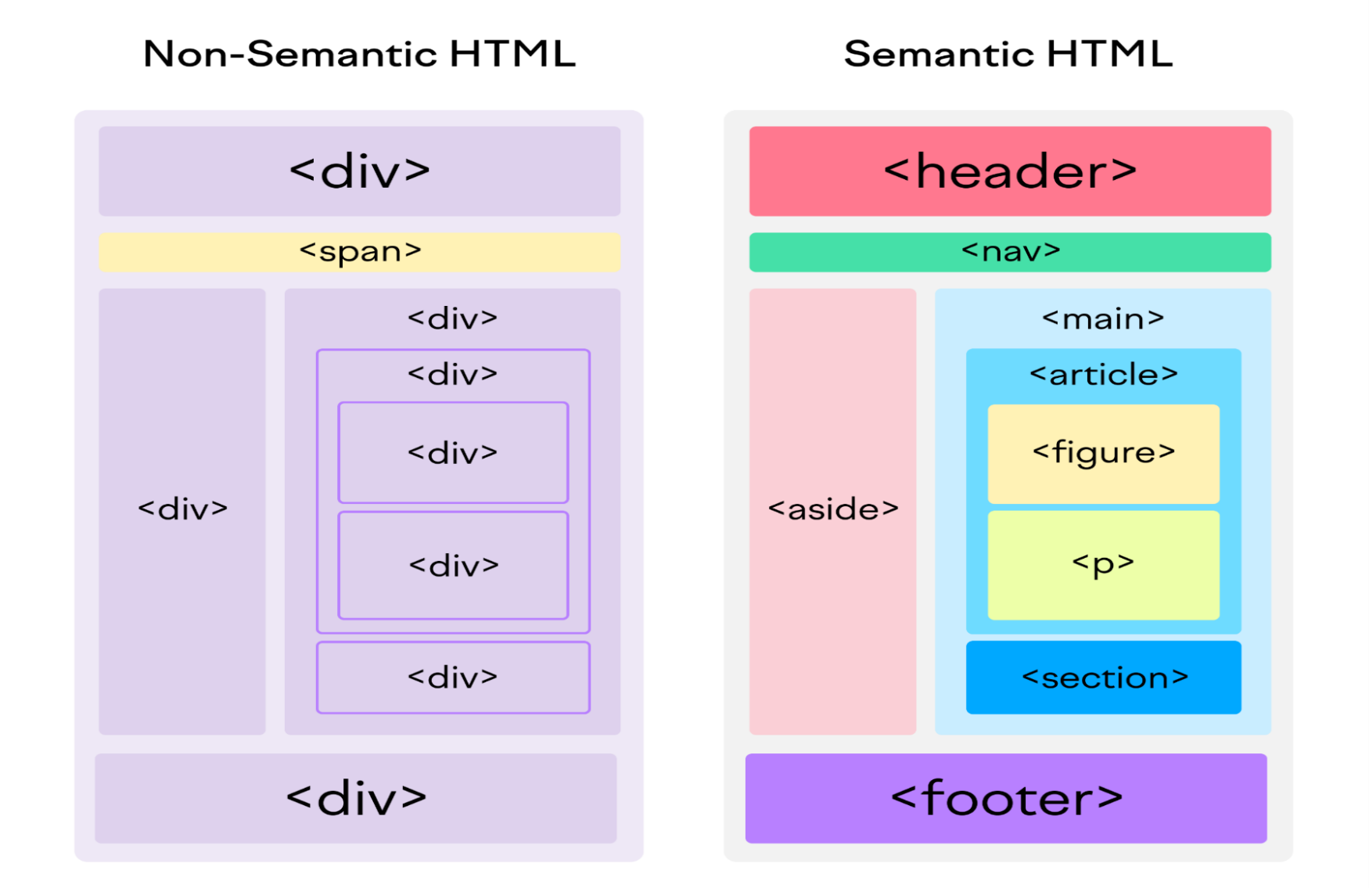
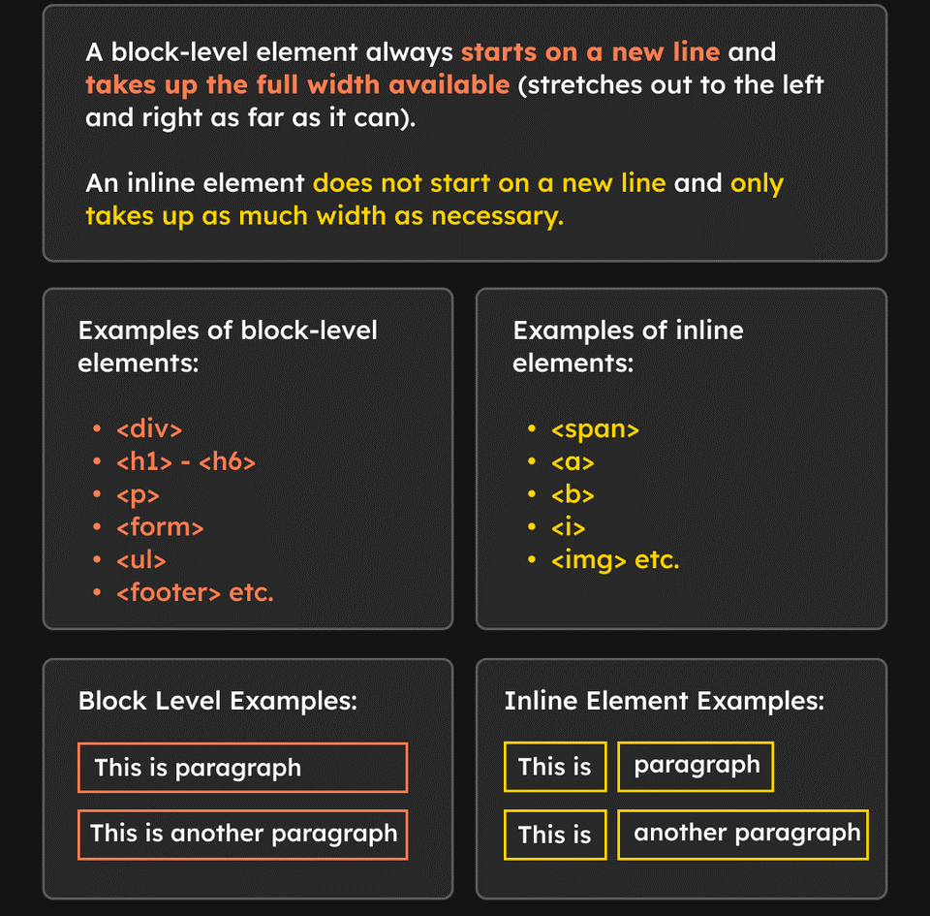
Grouping of Elements.
Block & Inline

Slide 9
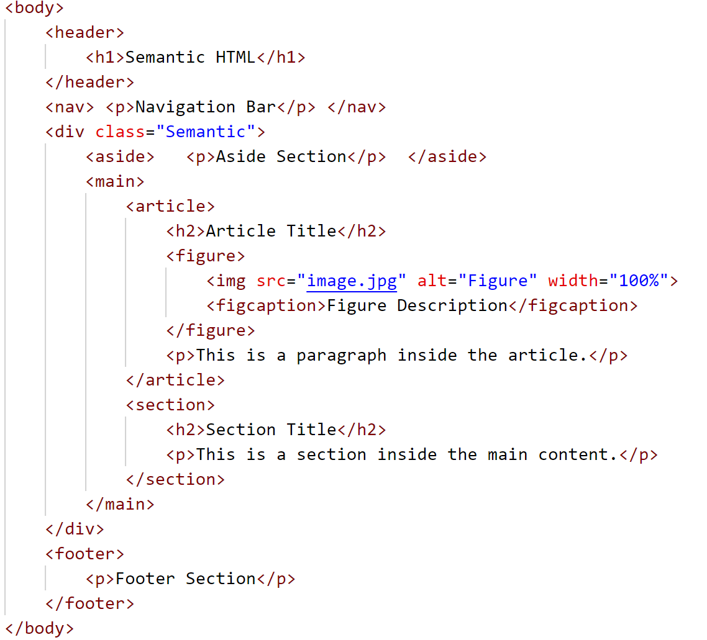
Semantic Tags
With semantic tags, both developers and browsers understand the purpose of each section of the page, enhancing code clarity.
Search Engine Optimization (SEO)
Semantic HTML tags improve the searchability of web content. Search engines like Google, Bing, and Yahoo crawl websites by interpreting the HTML structure, assigning more importance to certain tags in the content hierarchy.
For example: Content inside <h1>, <h2>, and <p> tags is given more weight in the ranking algorithm than content inside generic tags like <div>.
Search engines interpret the content inside <h1> as being the primary focus of the page. This improves the page’s relevance in search engine rankings.
By using the appropriate tags, such as:
<h1> for the main heading <h2> for subheadings
<article> for blog posts or standalone content
<section> for distinct areas of the document you provide clear signals to search engines about the page’s content.

Slide 10
<div> & <span> Tag
The <div> tag
The <div> tag is a block level element. That means it will cause a line break, similar to a “p” or a “h1”. Think of it as a customizable holding box for other elements. When placed inside of this box, other elements will take on its attributes. <div> tags have two important functions:
They are used to group sections of a page together and assign certain properties
They are used in page layout
The <span> tag
Like the <div> tag, the <span> tag is used to link style sheet rules to sections of a document.
However, the <span> tag is an inline element, meaning it will not cause a page break.
Like a <div> tag, a <span> tag will affect everything inside of it. <span> tags are generally used to format text, and will not affect the layout of a page.

Slide 11
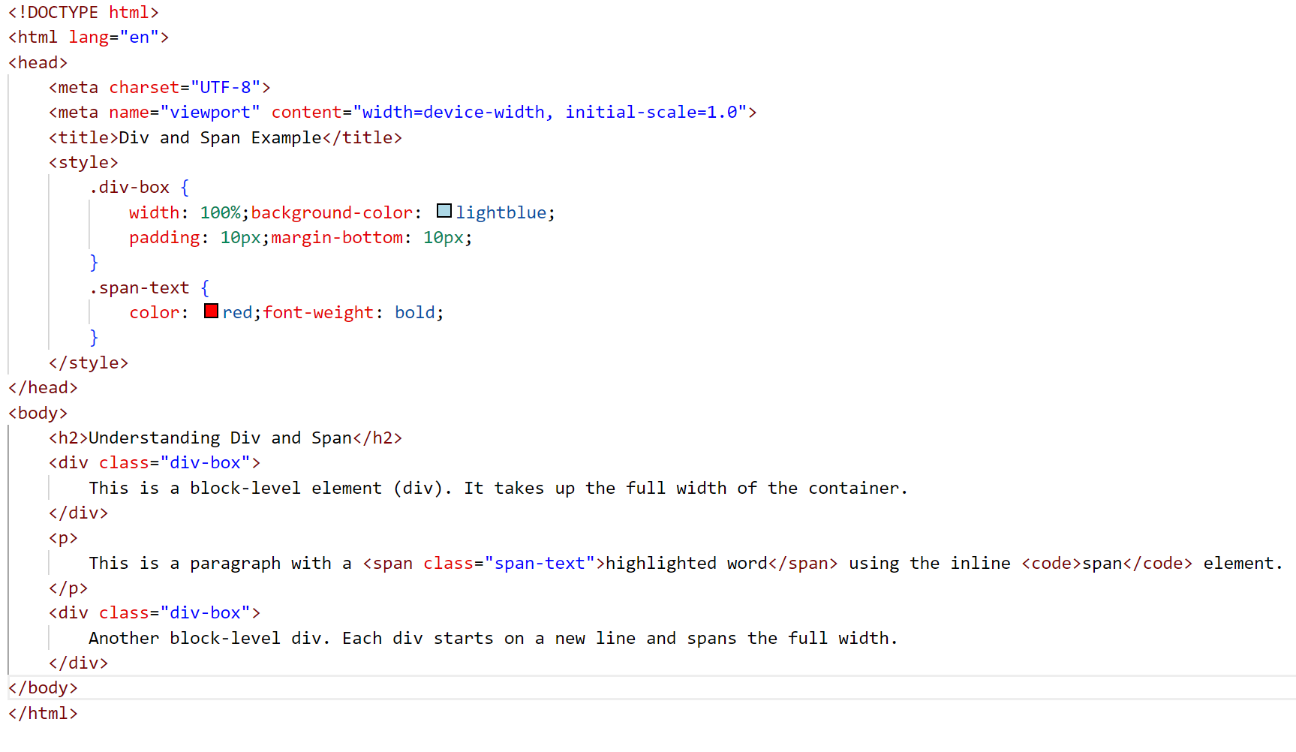
<div> & <span> Tag

Slide 12
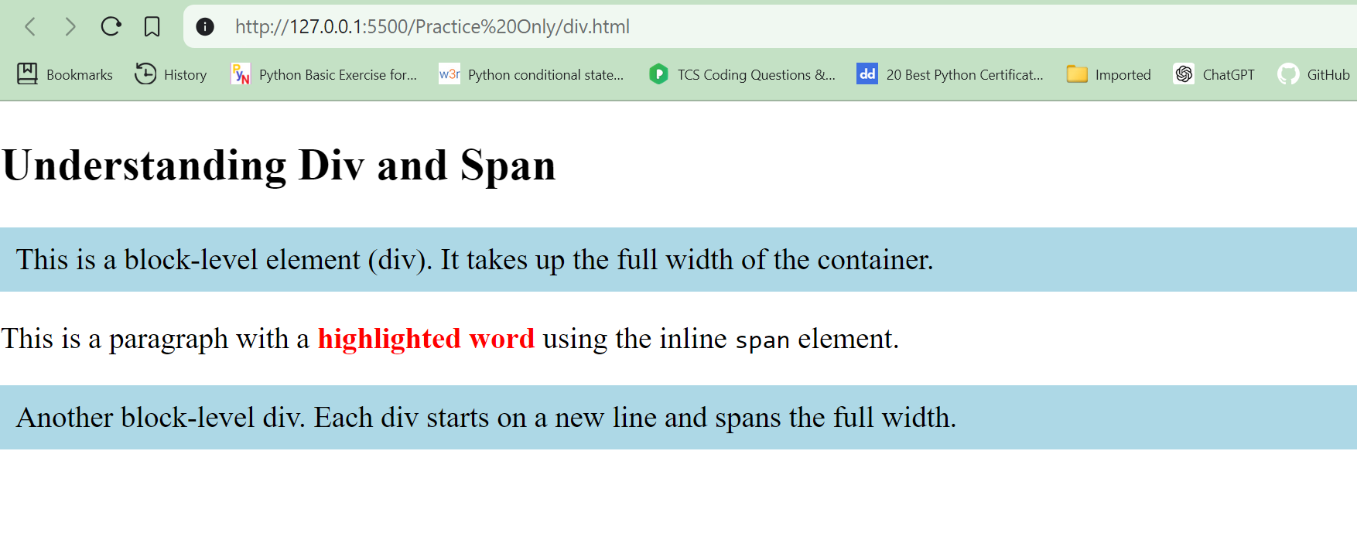
<div> & <span> Tag

Slide 13
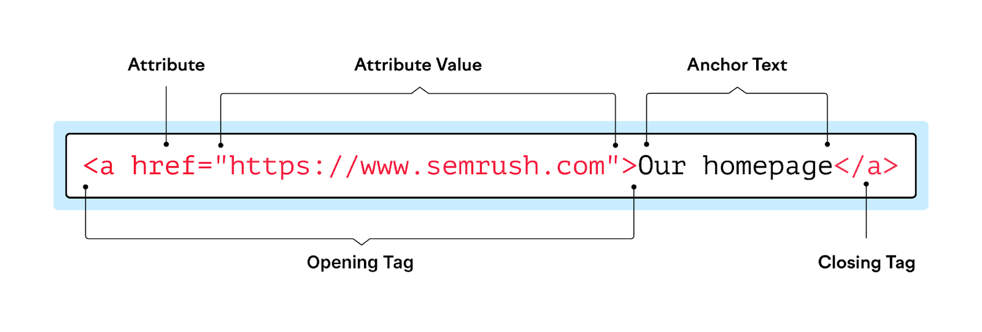
Anchor Tag
With HTML (HyperText Markup Language), an anchor or hyperlink anchor is an area in hypertext containing the source or destination to a different address or other information. In HTML, an anchor begins with <a> and ends with </a>, as shown in the breakdown of an HTML tag.

Slide 14
Anchor Tag
Attribute | Purpose | Example | Required?
href | Specify the link's target URL | a href="domain.com" | Yes
name | Link to an anchor mark within the page | a name="backtotop" | No
target | Specify how the taget document should be opened, e.g. in a new tab | target="_blank" | No
title | Provide text that will be displayed when the user hovers over a link | title="hello! I am a link" | No
rel | Specifies the relationship between the source and the target document | rel="next" | No
Anchor Tag with name Attribute (Deprecated)

Slide 15
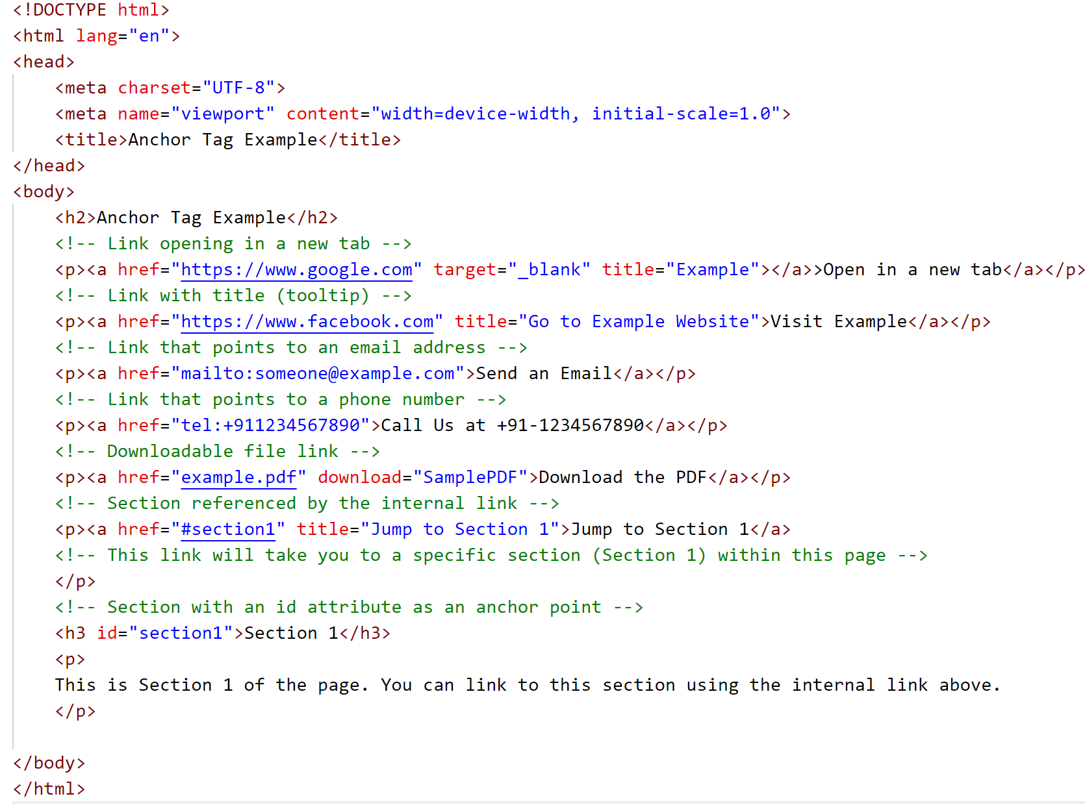
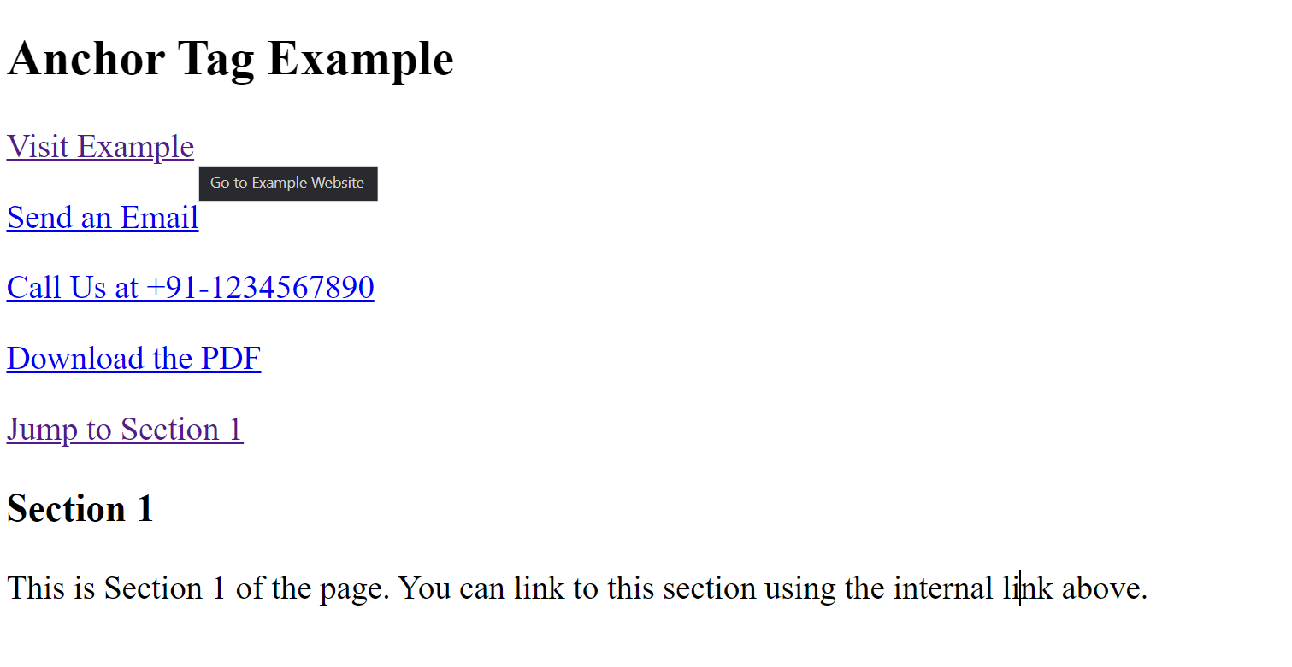
Anchor Tag

Slide 16
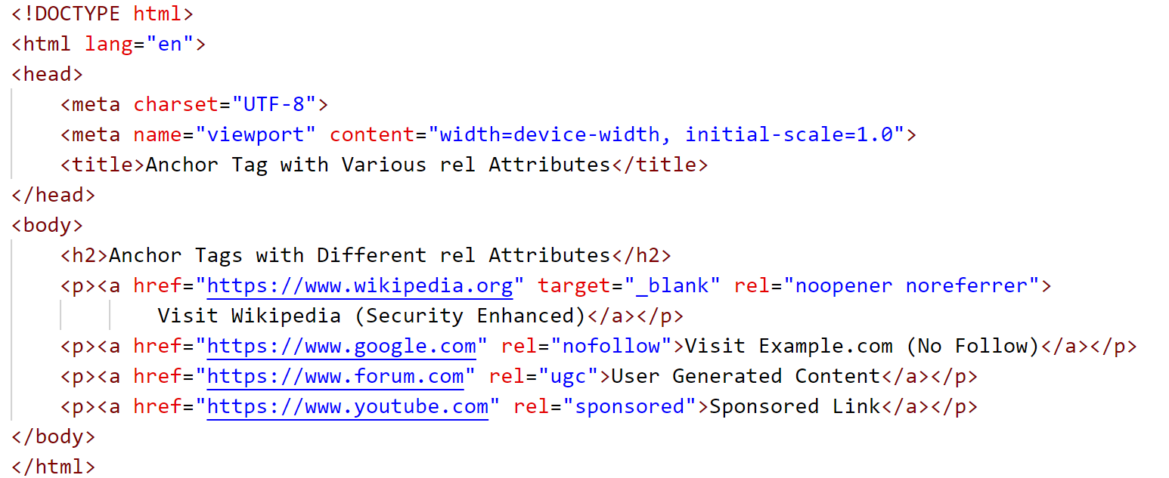
Anchor Tag
Rel
“Rel” is short for “relationship.” It states the relationship between the current resource and the one it links to.
Here’s an example of an HTML <a> tag with a “rel” attribute:
nofollow: Tells search engines not to follow this link or pass any SEO credit to the linked site
noopener: A security measure that prevents the linked resource from taking control of the current page when users click a link that opens in a new tab or window. So the linked resource can’t redirect users to a phishing scam or other unsafe pages.
noreferrer: prevents the browser from sending the Referrer header to the target website. The Referrer header contains information about the source of the request.
ugc: Indicates that the link is part of user-generated content, like blog comments or forum posts. This helps search engines understand the context of the link.
sponsored: Marks the link as sponsored content, such as an advertisement or affiliate link, helping search engines recognize

Slide 17
iframe
An HTML iframe(or Inline Frames) is an HTML tag that allows you to embed another HTML document within a current HTML document.
The < iframe > element can be used to insert content such as web pages, videos, maps, etc., within an existing web page, creating a window or frame in the web page where the embedded content can be displayed.
Here is a basic syntax of an iframe element:
<iframe src="URL" width="width_in_px" height="height_in_px"> </iframe>
In this syntax:
<iframe> is the tag that initiates the iframe.
The src attribute specifies the URL of the page to display in the iframe.
The width and height attributes define the dimensions of the iframe.

Slide 18
iframe
Why Use iFrames?
iFrames offer a variety of use-cases:
Content Isolation: iFrames allow you to isolate third-party content, which can improve security.
Modularity: Easily embed external plugins, widgets, or content.
Resource Separation: Content within an iFrame can load separately from the rest of the page.
Attributes of iFrame:
Several attributes can enhance the functionality of an iFrame:
src: Specifies the URL of the page to embed.
height and width: Define the dimensions.
frameborder: Indicates whether to display a border.
scrolling: Controls the scrollbars.
name: For targeting the iFrame in JavaScript.

Slide 19
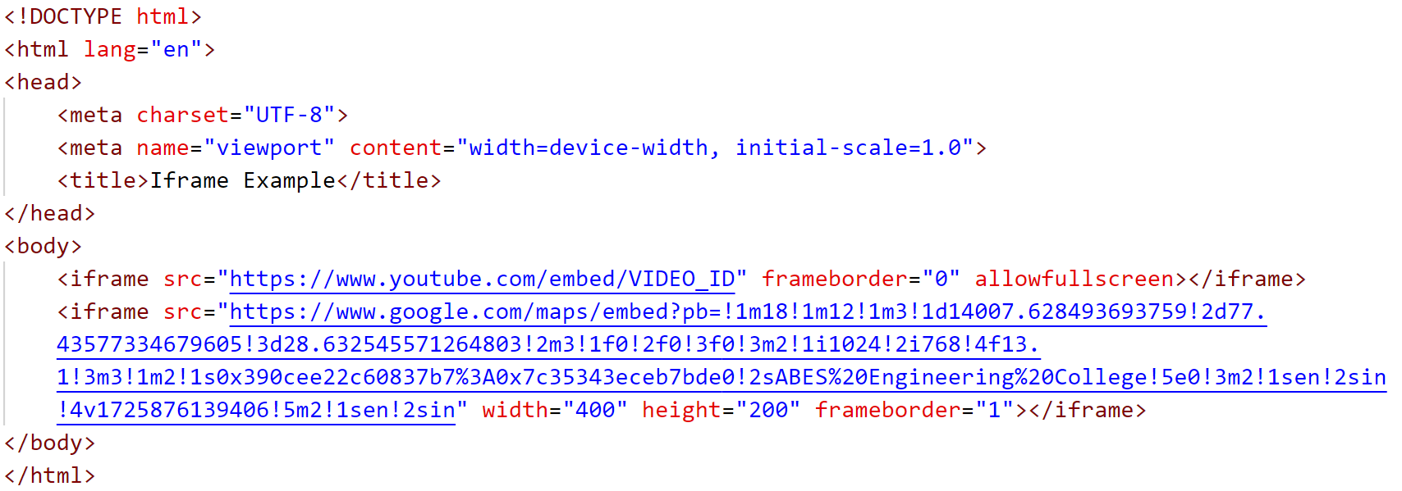
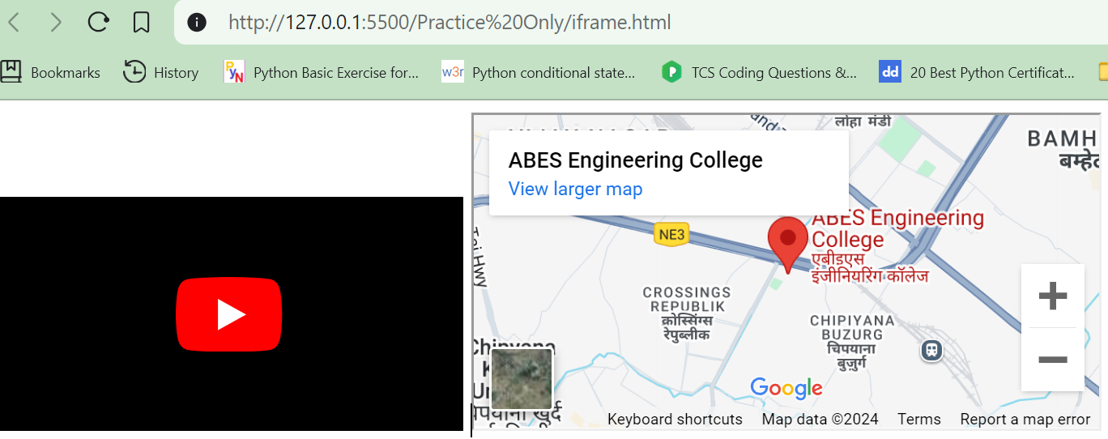
iframe

Slide 20
Image Tag
Images play a crucial role in enhancing web pages by providing a visual context that complements textual content. In HTML, the <img> tag is used to embed images into web pages.
Key Features of the <img> Tag:
It's a self-closing tag, meaning it doesn't require a corresponding closing tag. Commonly used attributes include the "alt" attribute for image descriptions and the "src" attribute for specifying the image location.
Supports various image formats including PNG, JPEG, JPG, and GIF.
Mandatory Attributes
The "src" and "alt" attributes are essential for the proper functioning of the <img> tag.
src attribute: Specifies the path to the image file.
alt attribute: Provides a text description for the image.

Slide 21
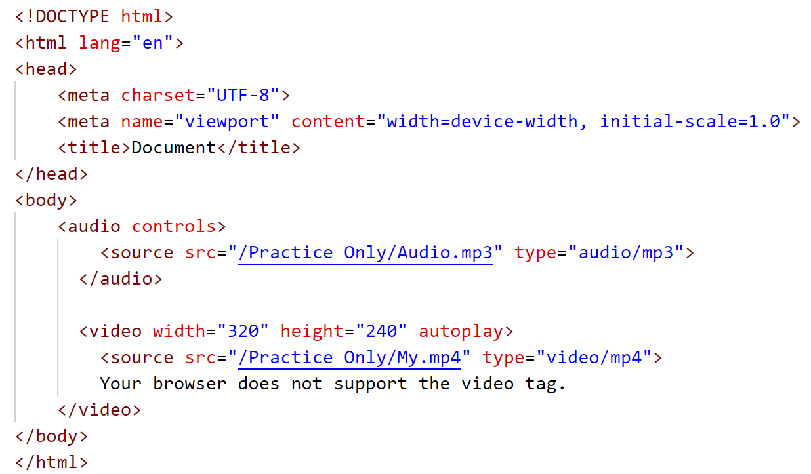
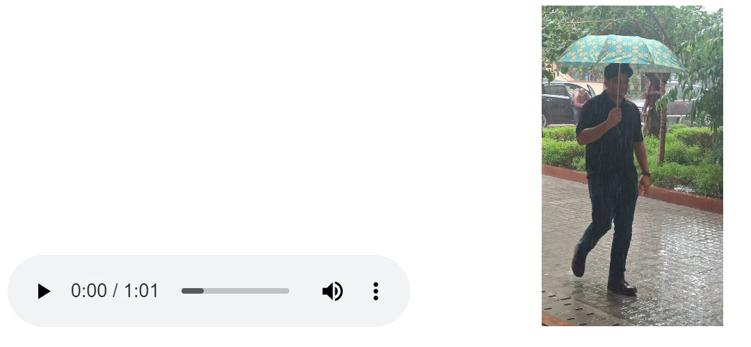
HTML Audio / Video
The HTML <audio> tag is used to embed a media player which supports audio playback into the HTML page. We use the HTML <audio> tag along with the <source> tag to add the audio player. For example,

Slide 22
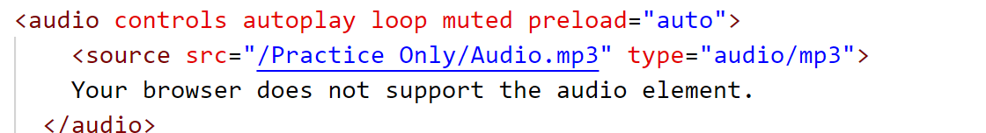
HTML Audio / Video
Let us look at the attributes supported by the HTML <audio> <video> tags.
controls: Displays the default audio player controls (play, pause, volume, etc.).
autoplay: Automatically starts playing the audio as soon as the page loads.
loop: Makes the audio repeat continuously once it finishes.
muted: Starts the audio in a muted state (without sound), and the user will need to unmute it.
preload="auto": Instructs the browser to load the entire audio file when the page loads for faster playback.

Slide 23

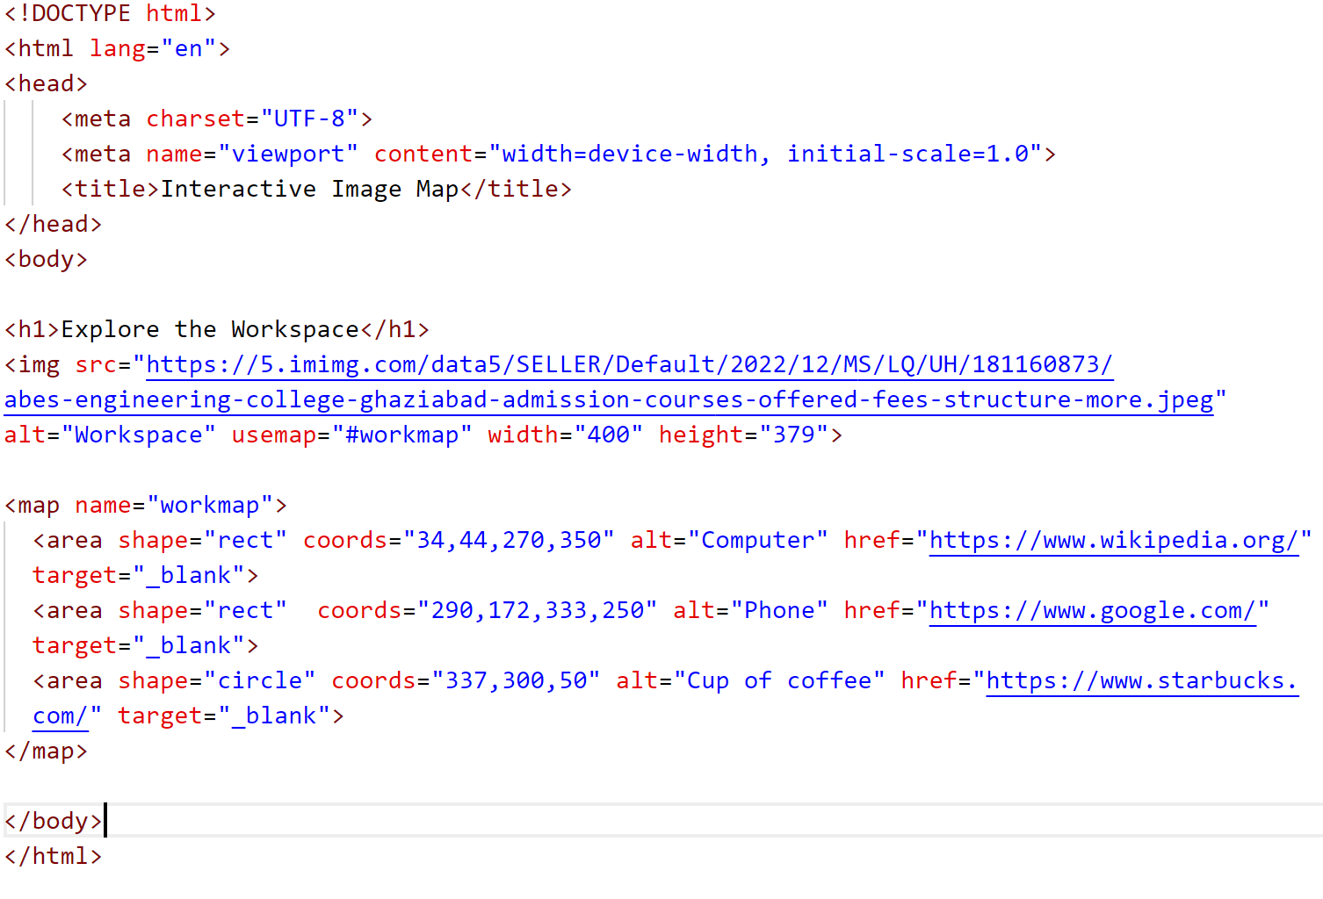
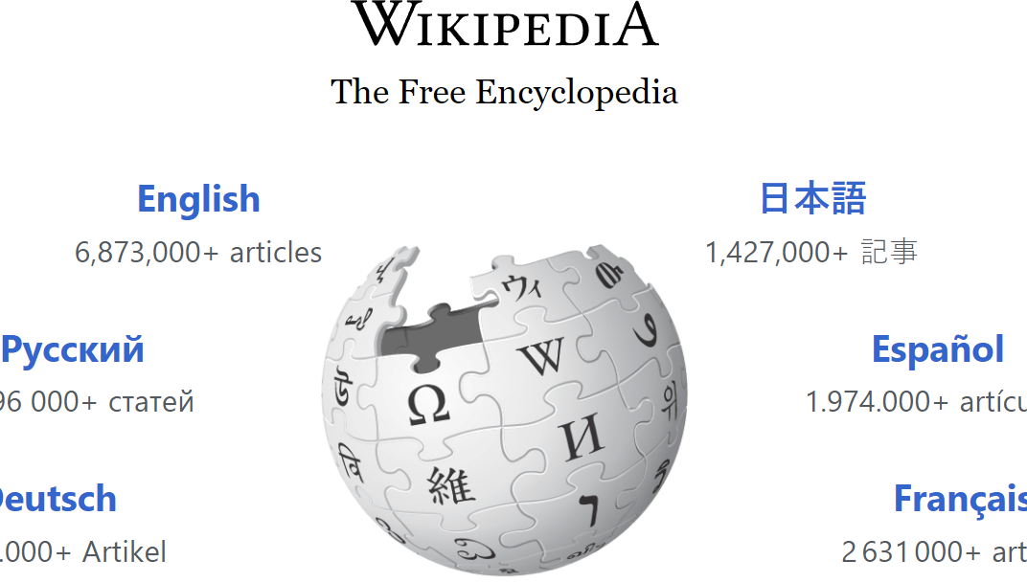
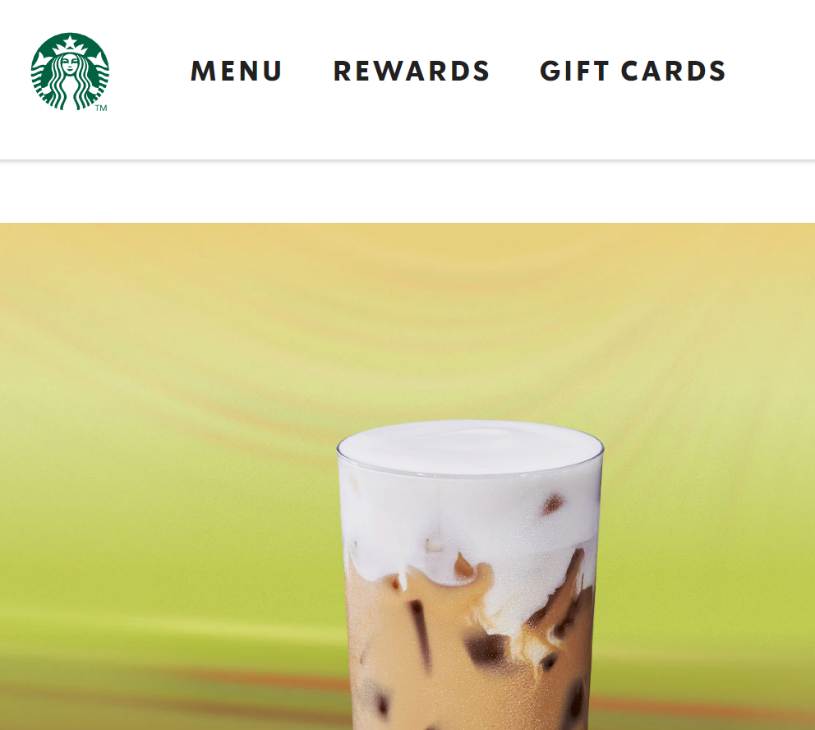
HTML Map
The <map> tag in HTML is used to define image maps, which are clickable areas within an image. An image map allows you to link different parts of a single image to different destinations (URLs). This is particularly useful when you have an image containing various regions or sections that you want to link separately.

Slide 24
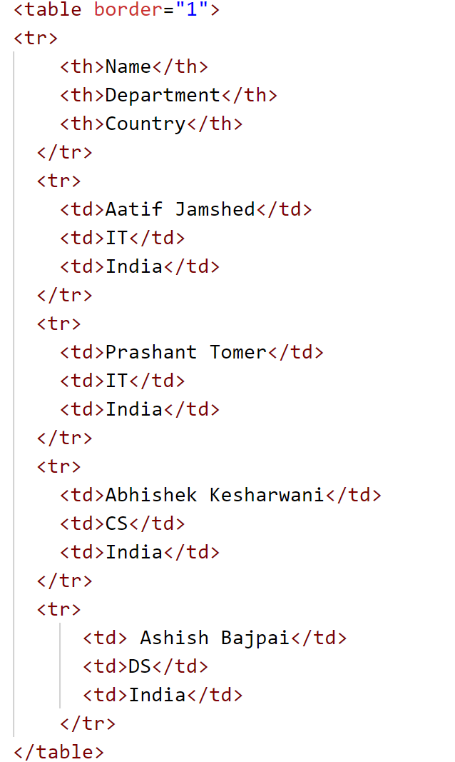
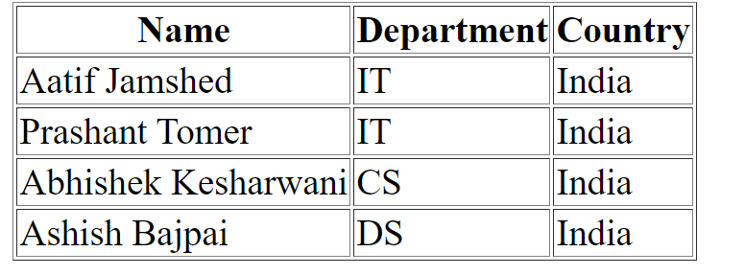
HTML Table
The HTML table tag (<table>) is used to represent data in a structured way by creating a table. For example,

Slide 25
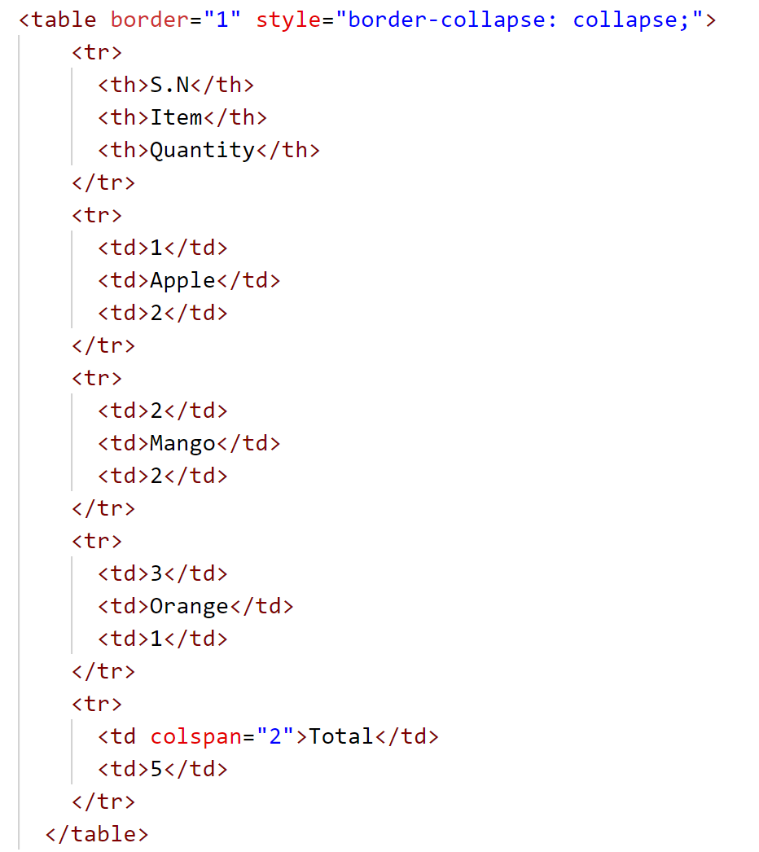
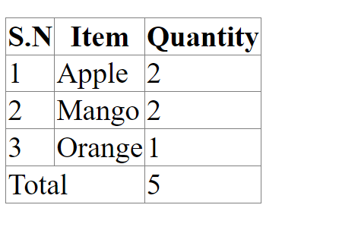
HTML Table
Colspan
The colspan attribute merges cells across multiple columns. For example,

Slide 26
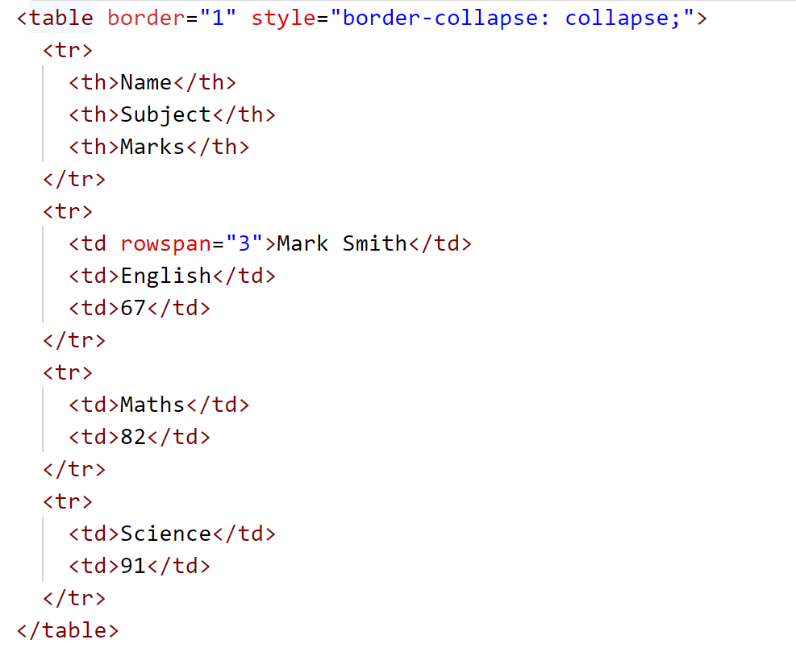
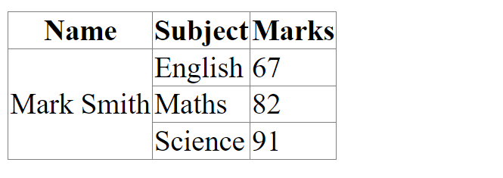
HTML Table
Rowspan
The rowspan attribute merges cells across multiple rows. For example,

Slide 27
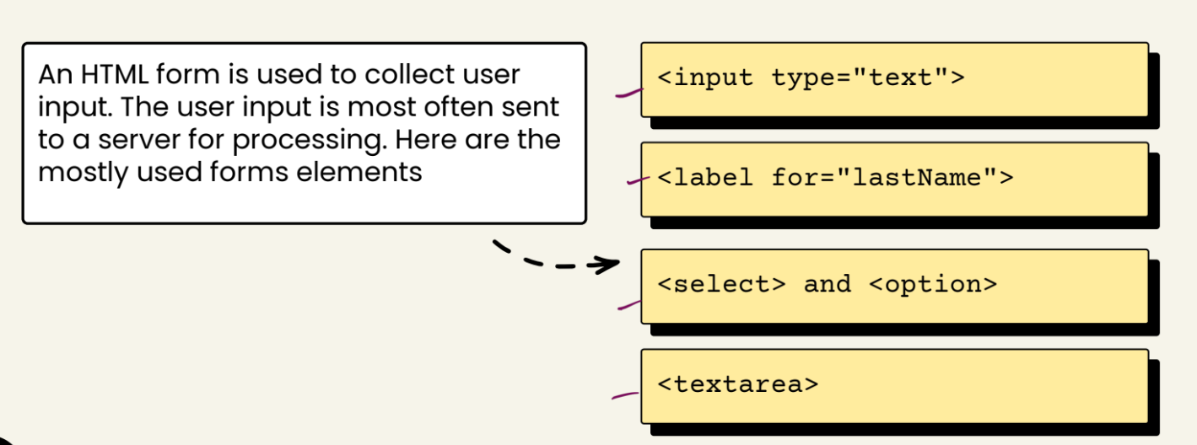
HTML Forms

Slide 28
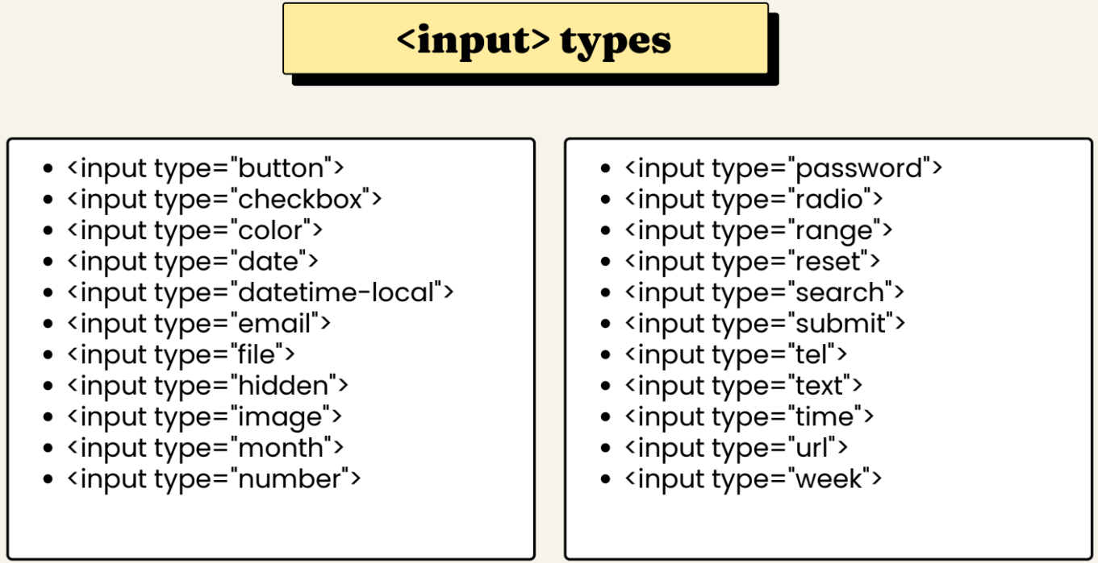
HTML Forms

Slide 29
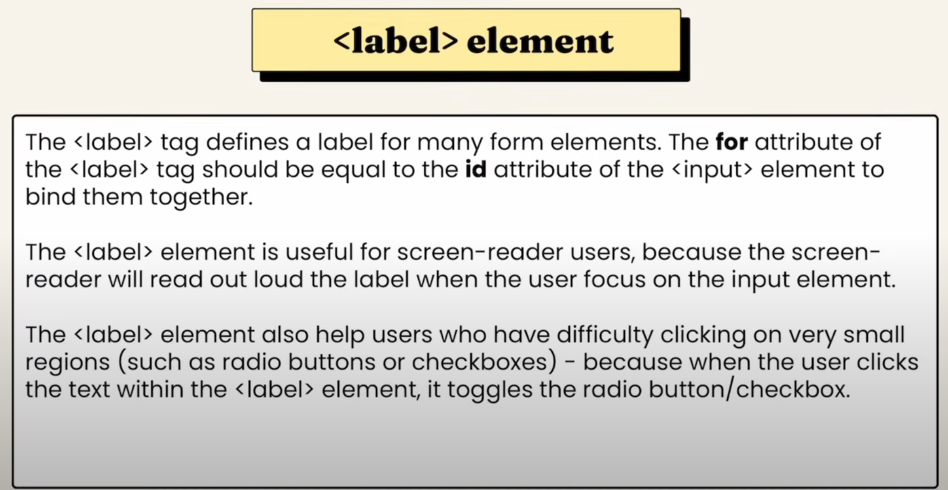
HTML Forms

Slide 30
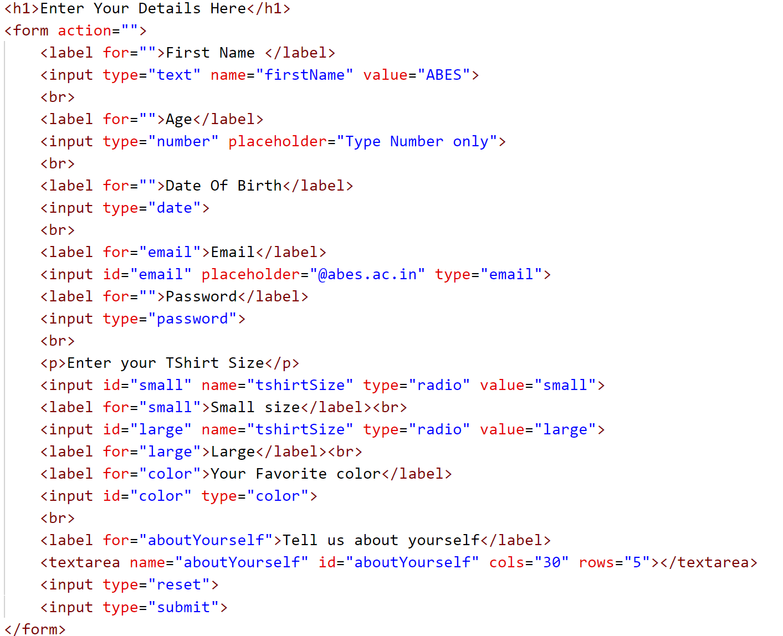
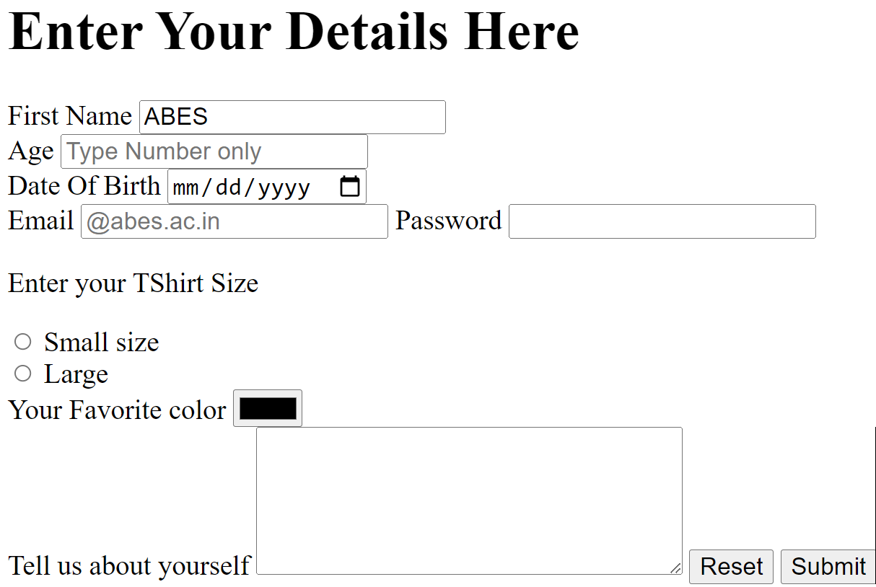
HTML Forms

Slide 31
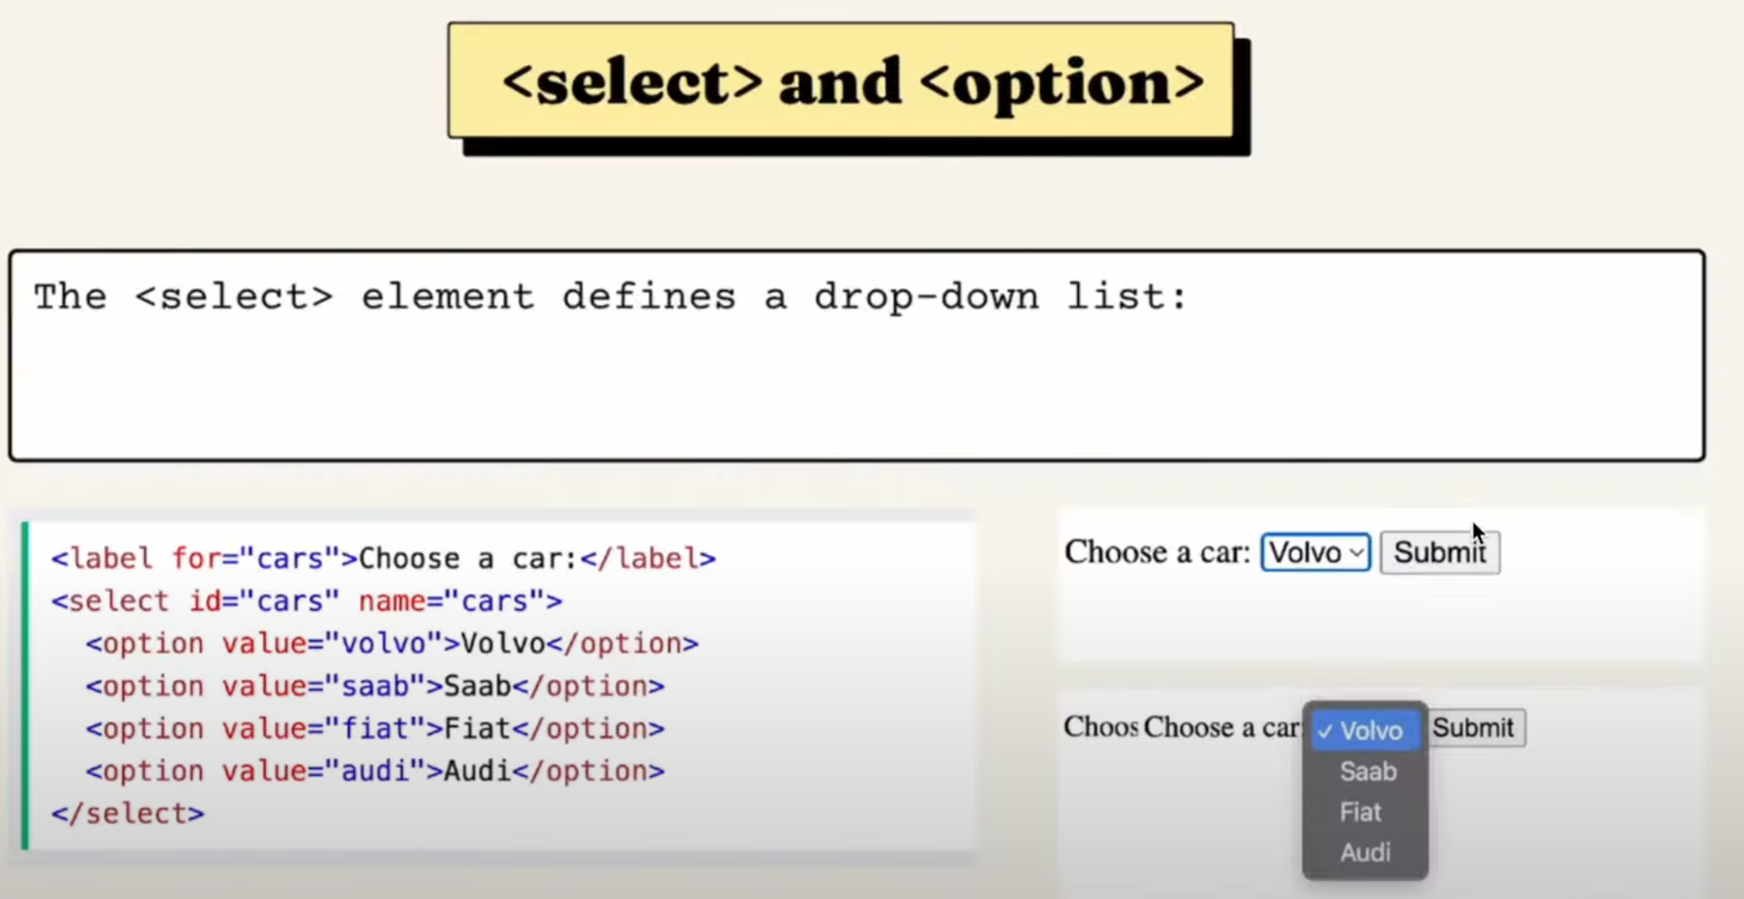
HTML Forms

Slide 32
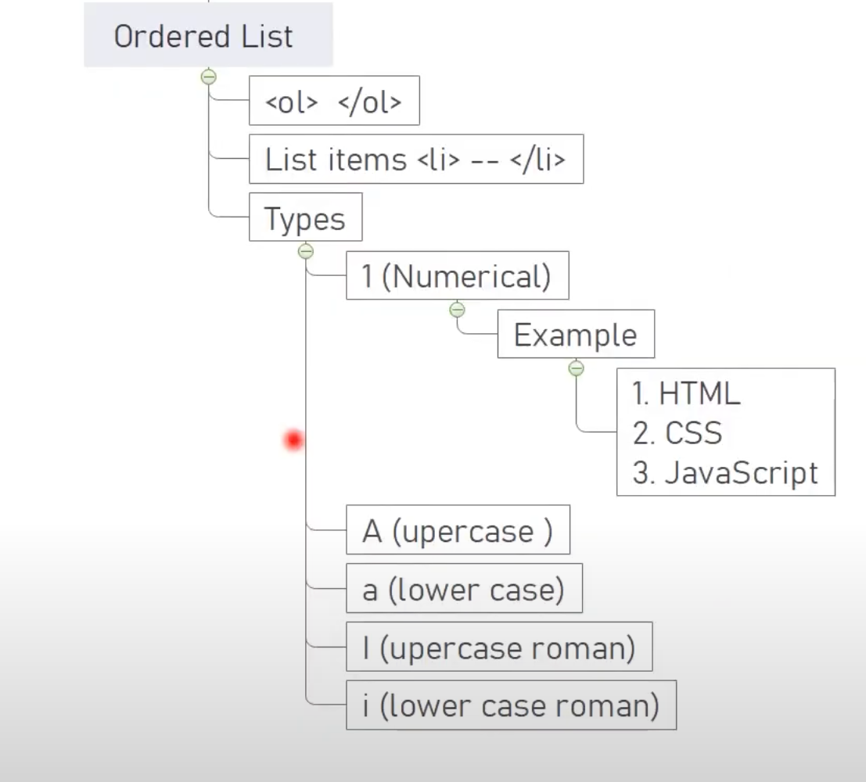
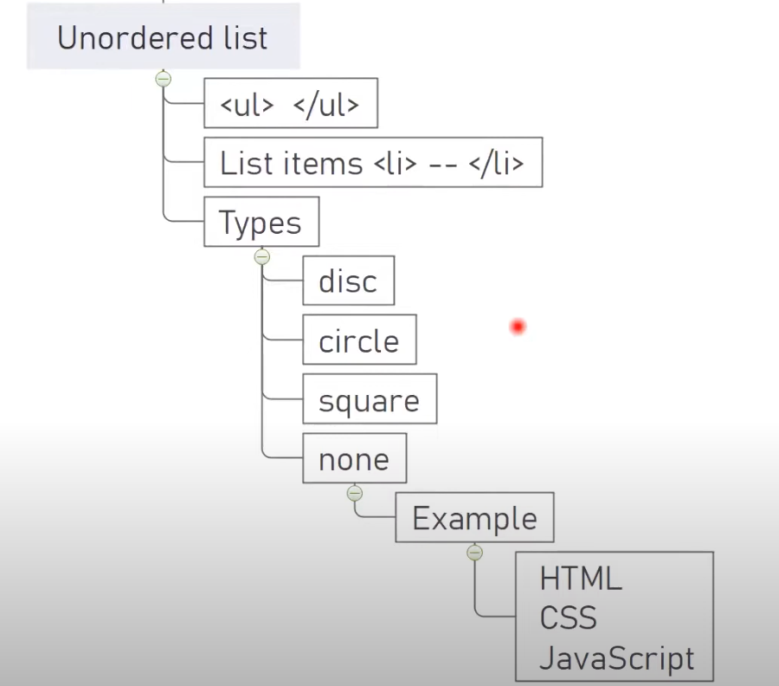
HTML List

Slide 33
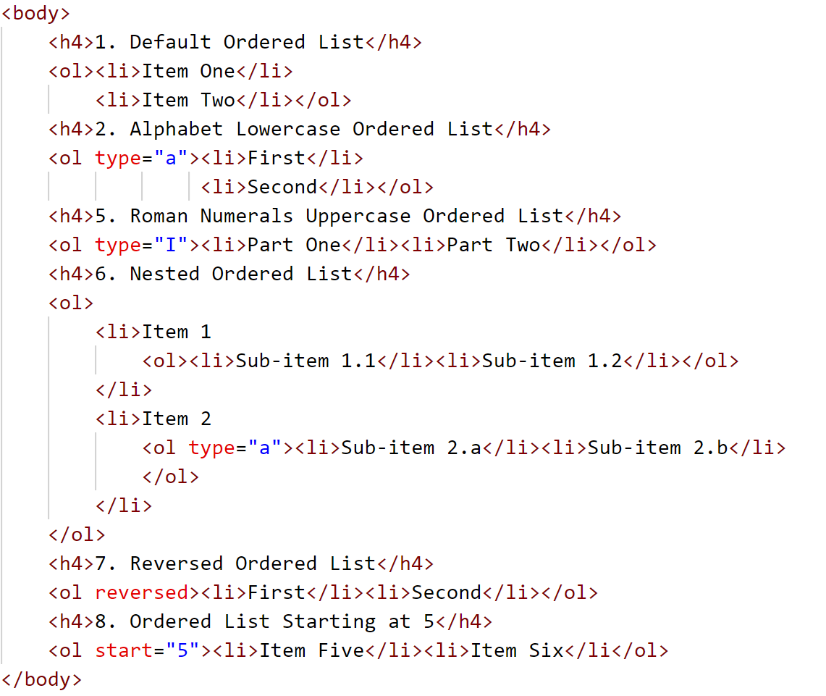
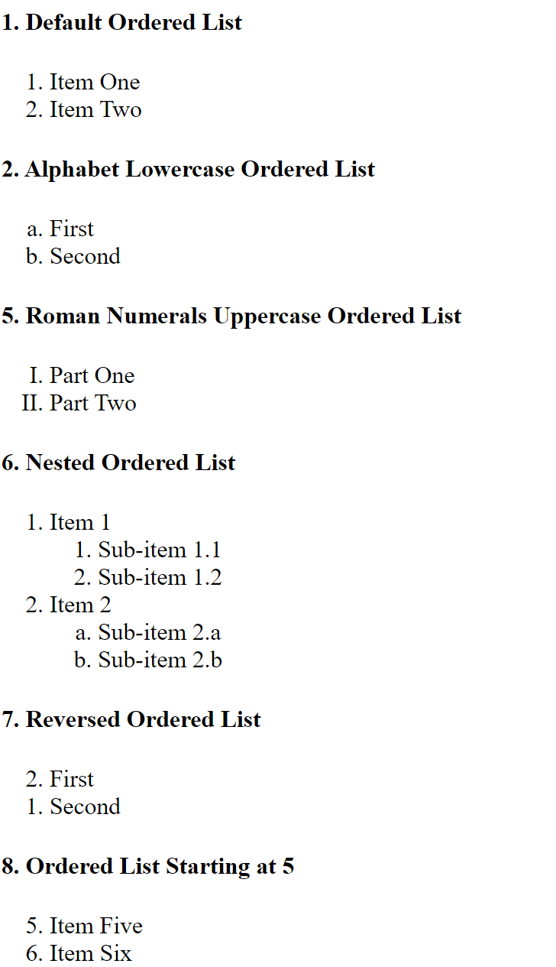
Ordered List

Slide 34
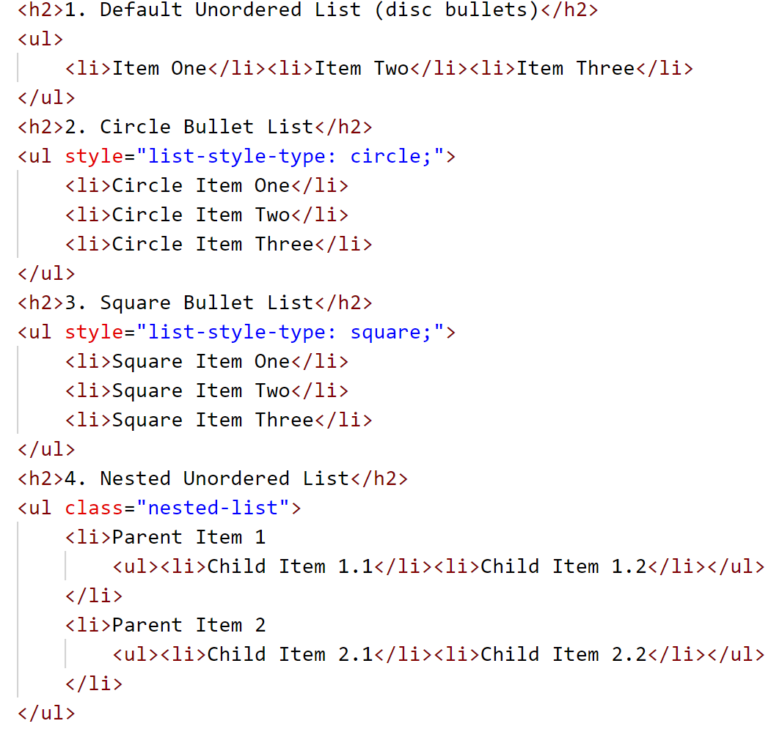
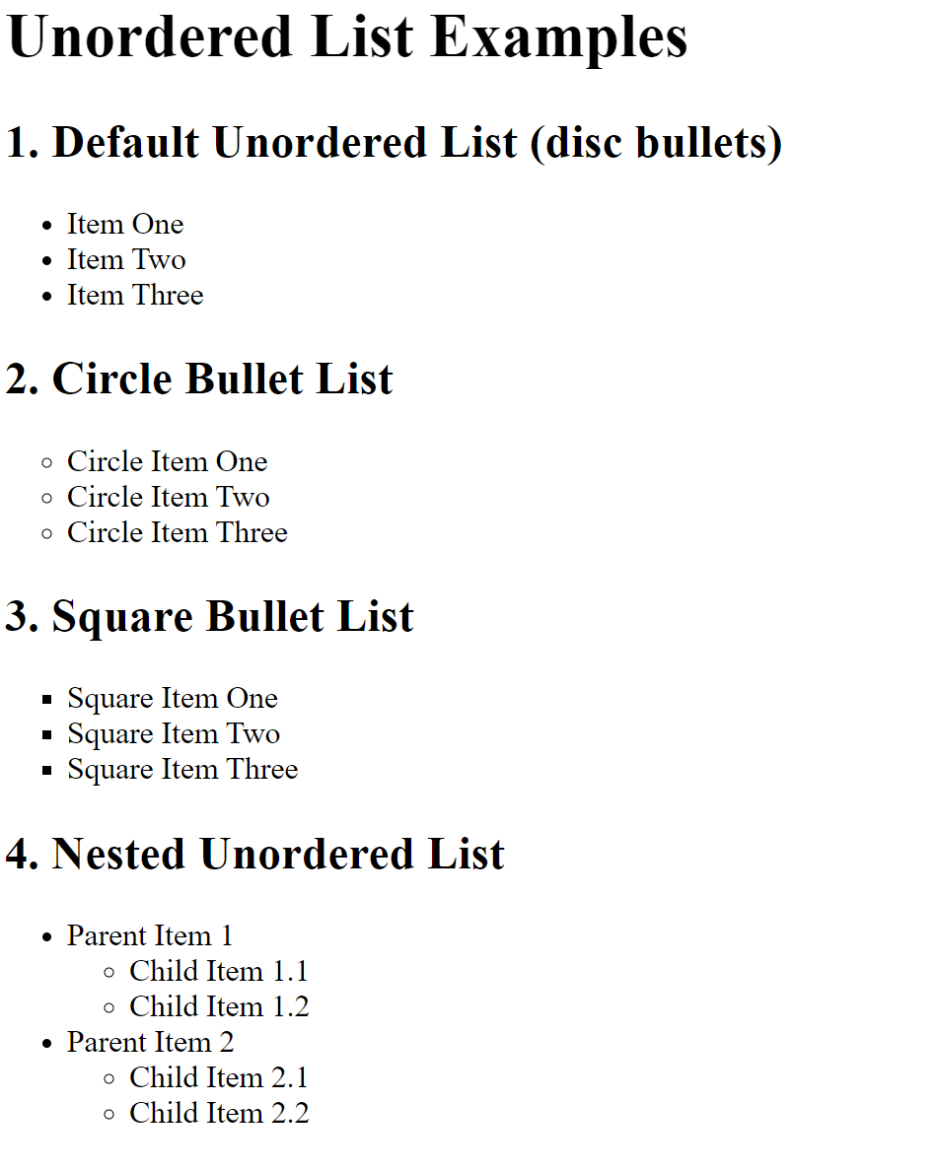
Unordered List

Slide 35
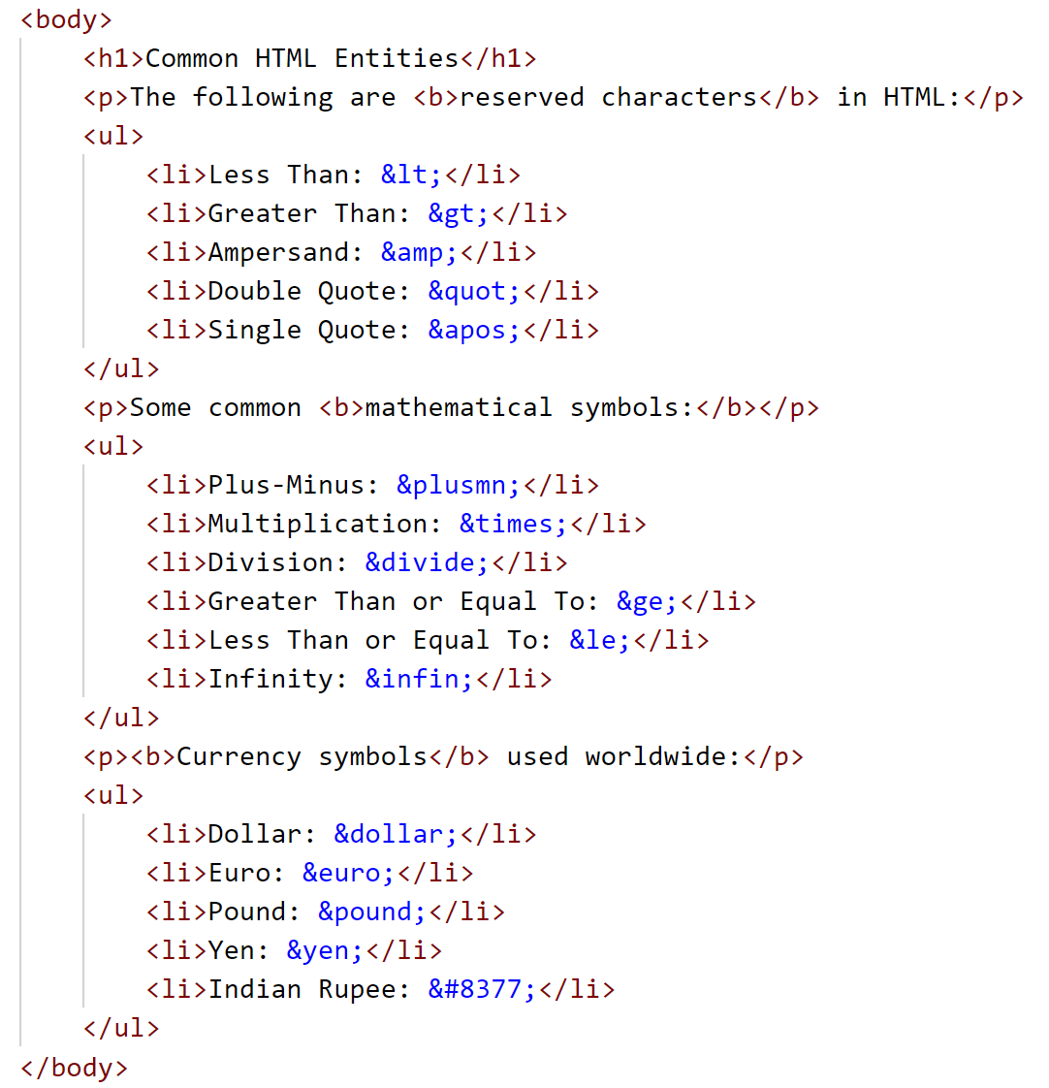
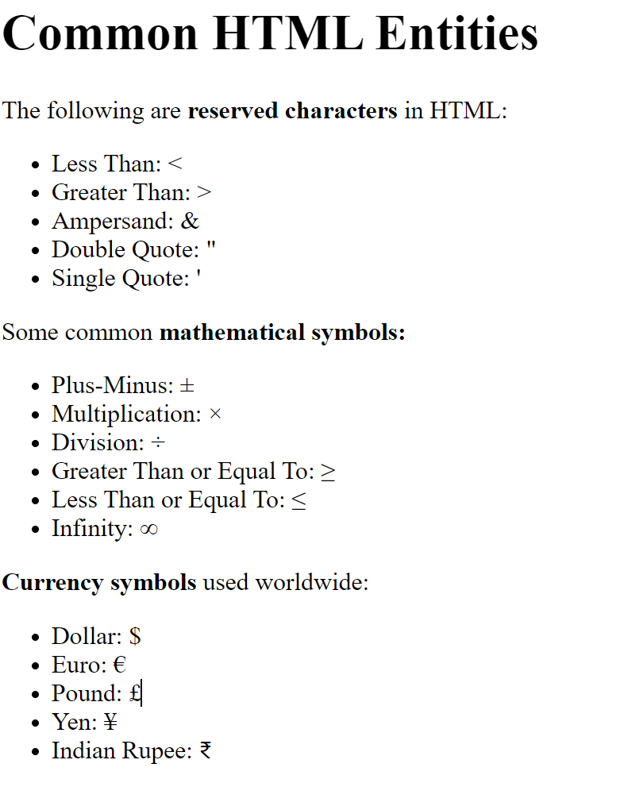
HTML Entities

Slide 36
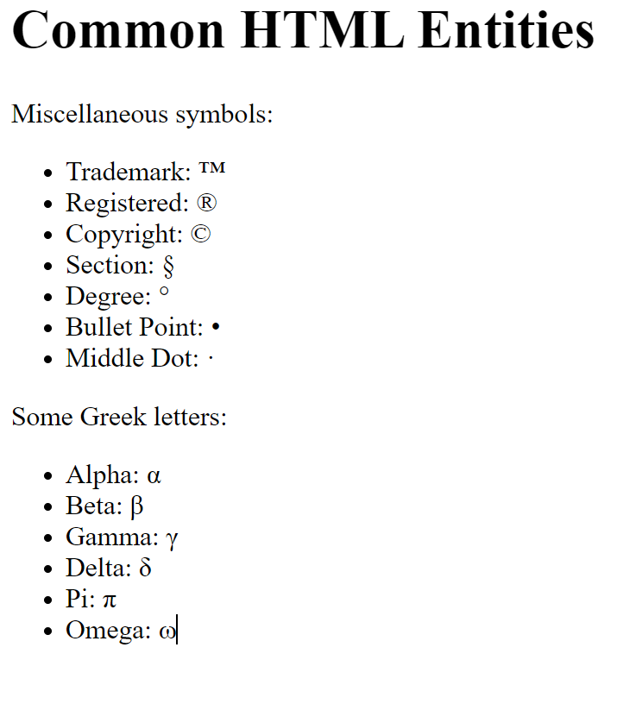
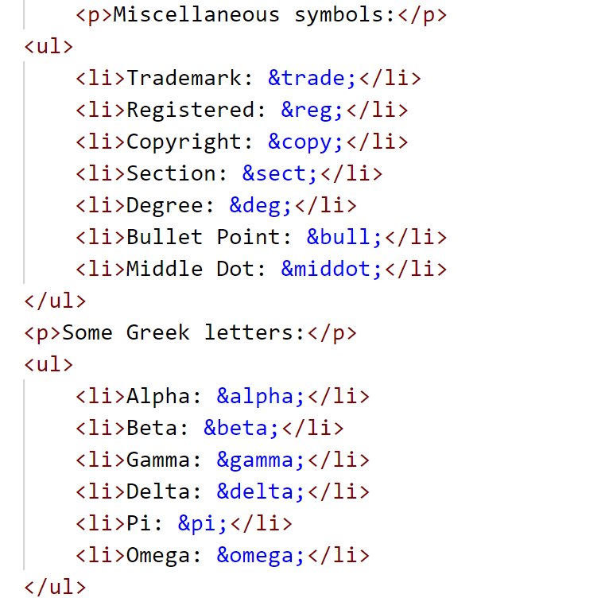
HTML Entities

Slide 37
References
HTML Living Standard by WHATWG https://html.spec.whatwg.org/
MDN Web Docs – HTML https://developer.mozilla.org/en-US/docs/Web/HTML
W3C HTML5 Recommendation https://www.w3.org/TR/html5/
"HTML and CSS: Design and Build Websites" by Jon DuckettBook on Amazon
Stack Overflow - HTML Discussions and Solutions https://stackoverflow.com/questions/tagged/html
W3Schools HTML Tutorial https://www.w3schools.com/html/

Slide 38
Thank You

